Slide 1
Ancillary Tools
Colin Jacobs
JWST MASTER CLASS MELBOURNE 2022

Slide 2
What are ‘Ancillary Tools’?
The JWST ETC and APT are the primary tools every proposer needs to create a JWST proposal.
However, many proposers may find it useful to perform some preliminary work to scope out their proposed science ideas.
For example: - is my target observable with JWST when I need to observe it? - what is the IR background level during the visibility periods?
Enter JWST Target Visibility Tools and Background Tool…
Notes:
Positiion angle also

Slide 3
Introduction: JWST Pointing, Target Visibility, and Position Angles

Slide 4
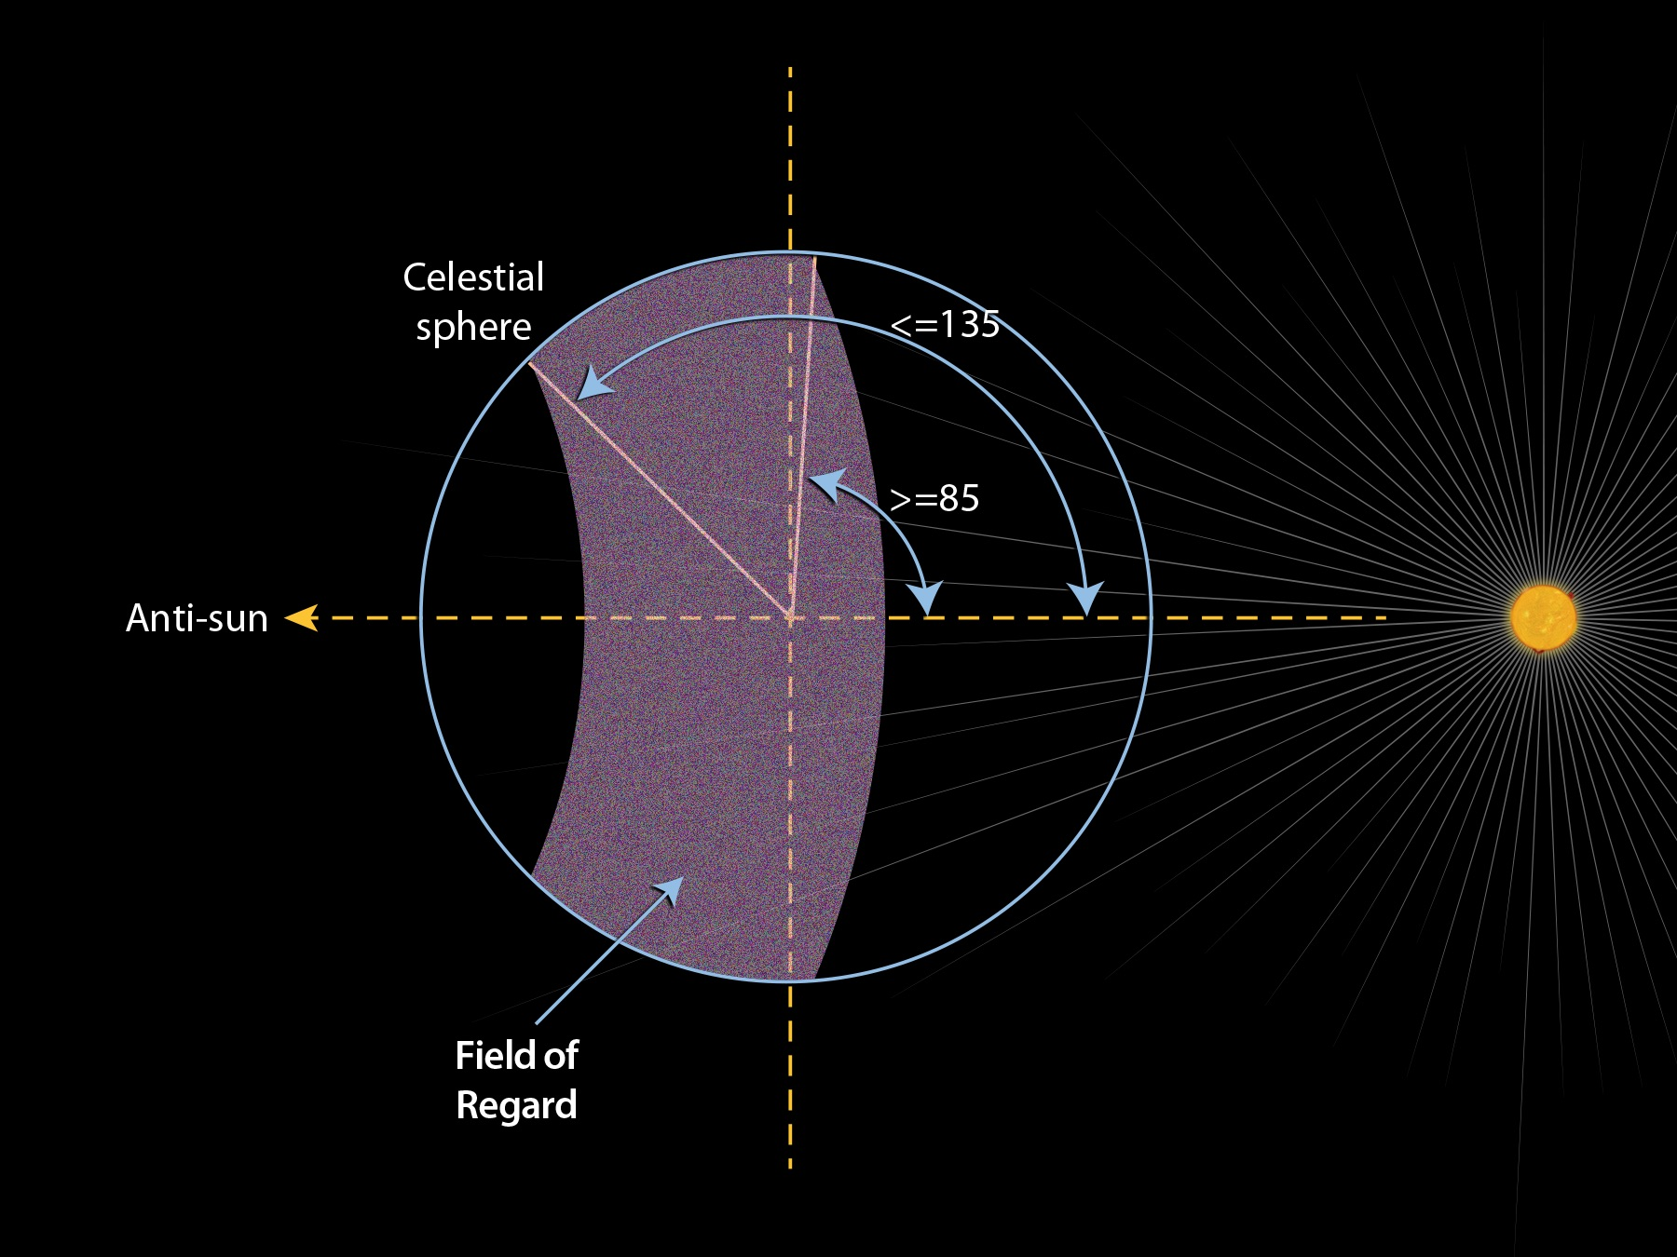
When Do I need to worry about Target Visibility?
JWST can observe the entire sky; just not all at the same time!
If your science targets have no timing or position angle constraints, you probably don’t need to concern yourself with the target visibility tools.
However, if timing and/or position angle is important, the TVTs can show you what is possible before creating an APT program.
The JWST Field of Regard (FoR)
At any one time, ~40% of the Celestial sphere is available for JWST observations
The FoR moves ~1º per day along the ecliptic equator
Notes:
In order to perpetually keep the telescope in the shade of the sunshield, the orientation of the JWST V1 axis (a.k.a. boresight or line of sight) wrt the Sun is limited to between 85 and 135 degrees, and the roll around the OTE boresight is limited to ± 5 degrees. As JWST orbits the sun, the FoR moves across the sky. This limits when an object can be observed by JWST, and for how long.

Slide 5
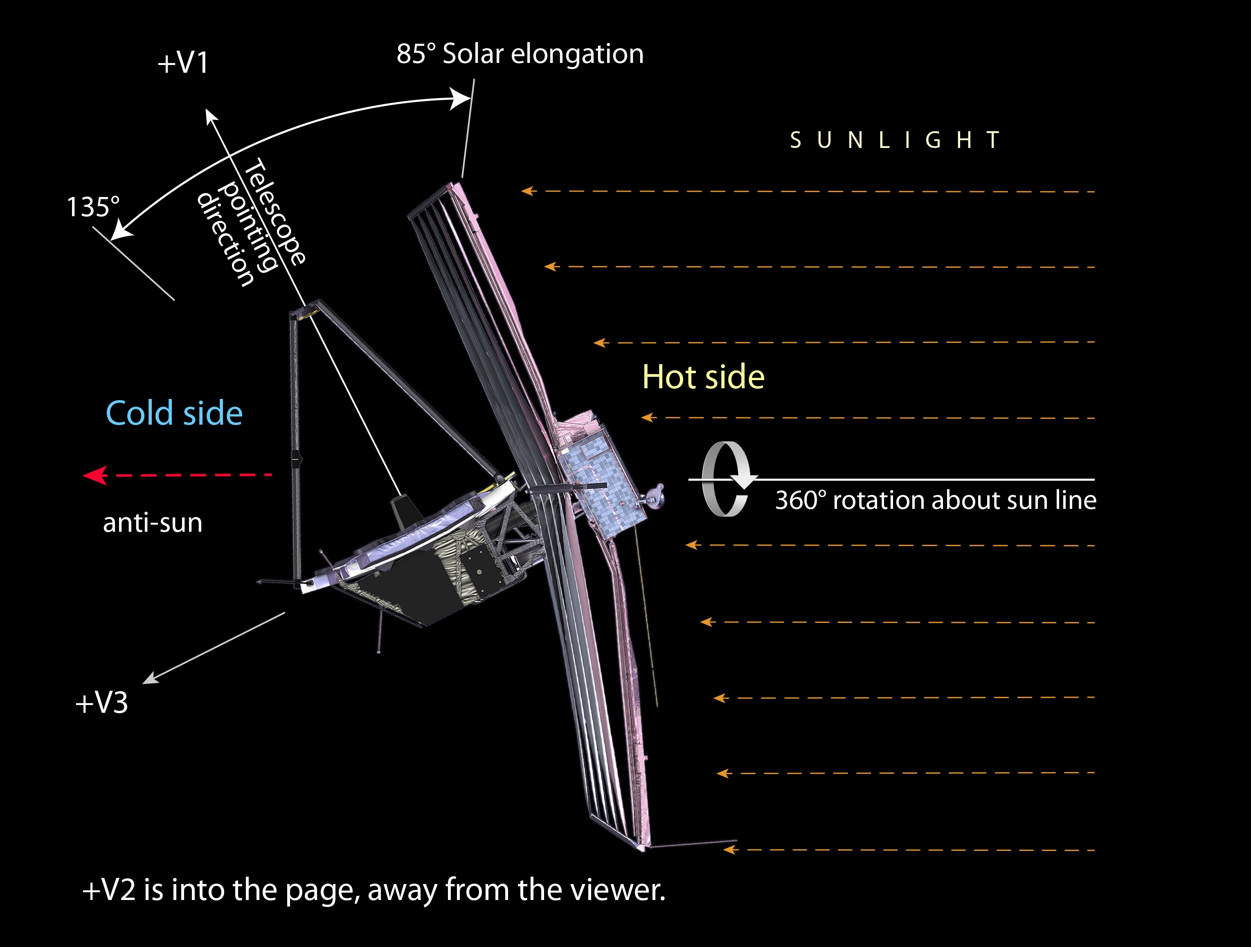
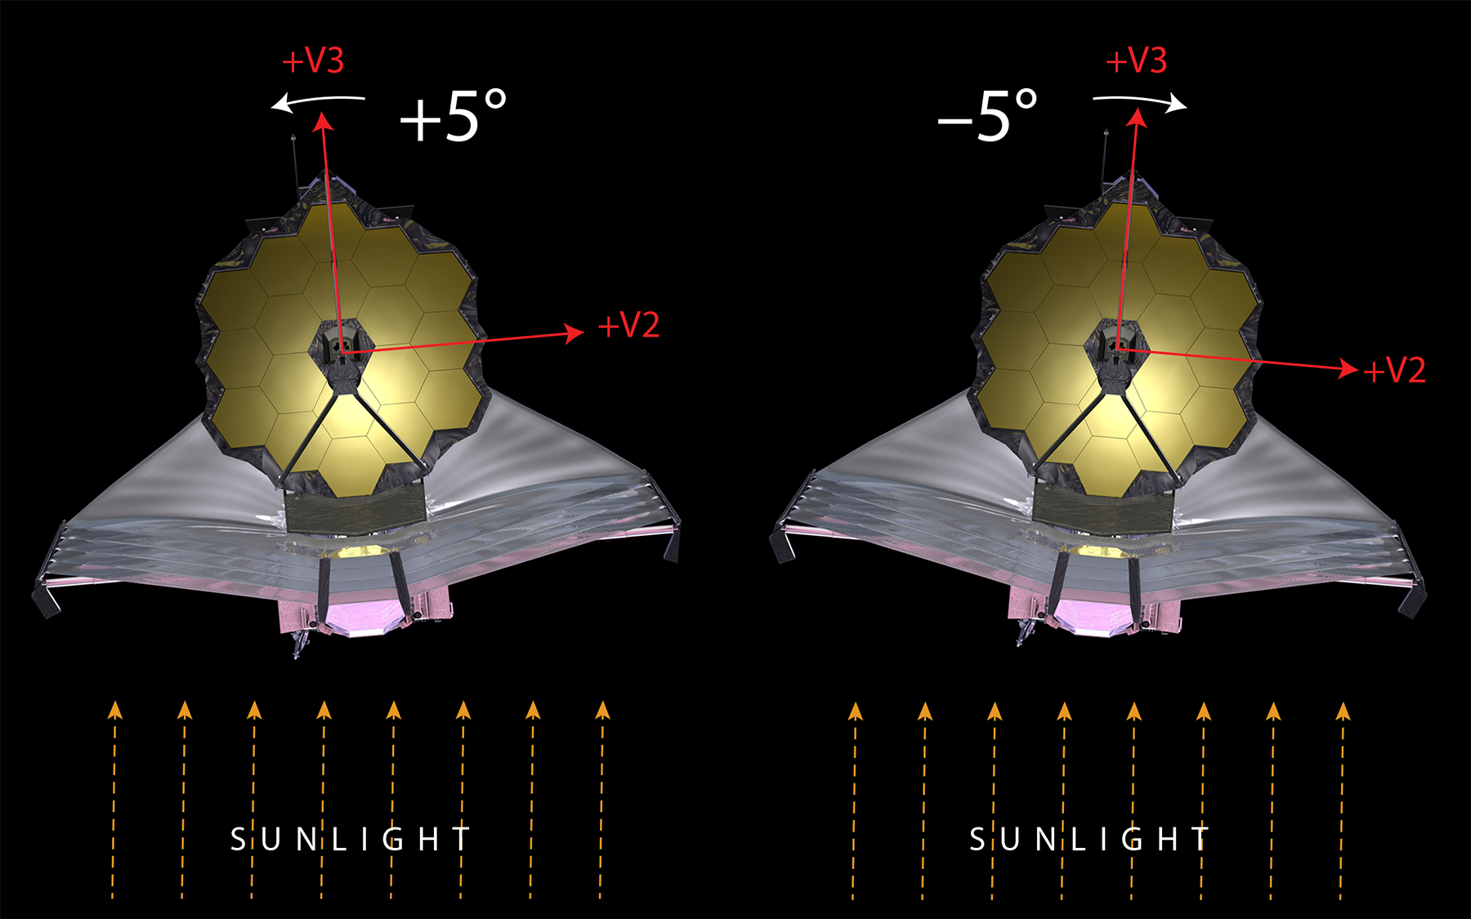
JWST Pointing Restrictions
JWST can rotate 360º about the sun line, but can only roll about the bore sight by ~5º.
This impacts the orientation of the JWST field of view on the sky, as well as target visibility.
Notes:
In order to perpetually keep the telescope in the shade of the sunshield, the orientation of the JWST V1 axis (a.k.a. boresight or line of sight) wrt the Sun is limited to between 85 and 135 degrees, and the roll around the OTE boresight is limited to ± 5 degrees. As JWST orbits the sun, the FoR moves across the sky. This limits when an object can be observed by JWST, and for how long.

Slide 6
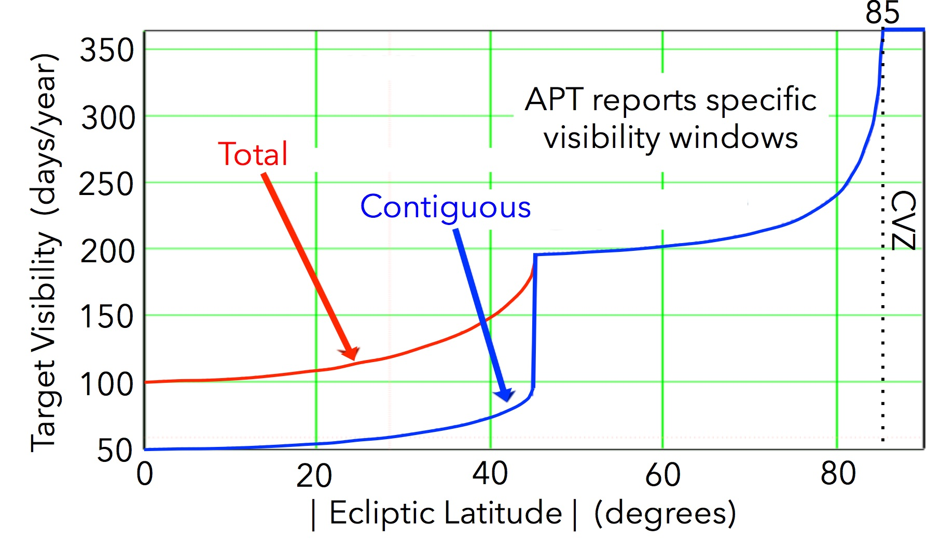
Visibility depends on Galactic Latitude
Targets below +/- 45º in ecliptic latitude have two ≳53d long visibility periods periods that are ~6 months apart, and have 180º roll angle difference.
Above +/- 45º, targets have one extended (> 180 d) visibility period, which gets longer with increasing ecliptic latitude.
Within ~5º of either ecliptic pole, there is a Continuous Viewing Zones (CVZ), inside which targets are always observable
Notes:
Red curve – blue curve x 2 (for latitude below 45 degs)

Slide 7
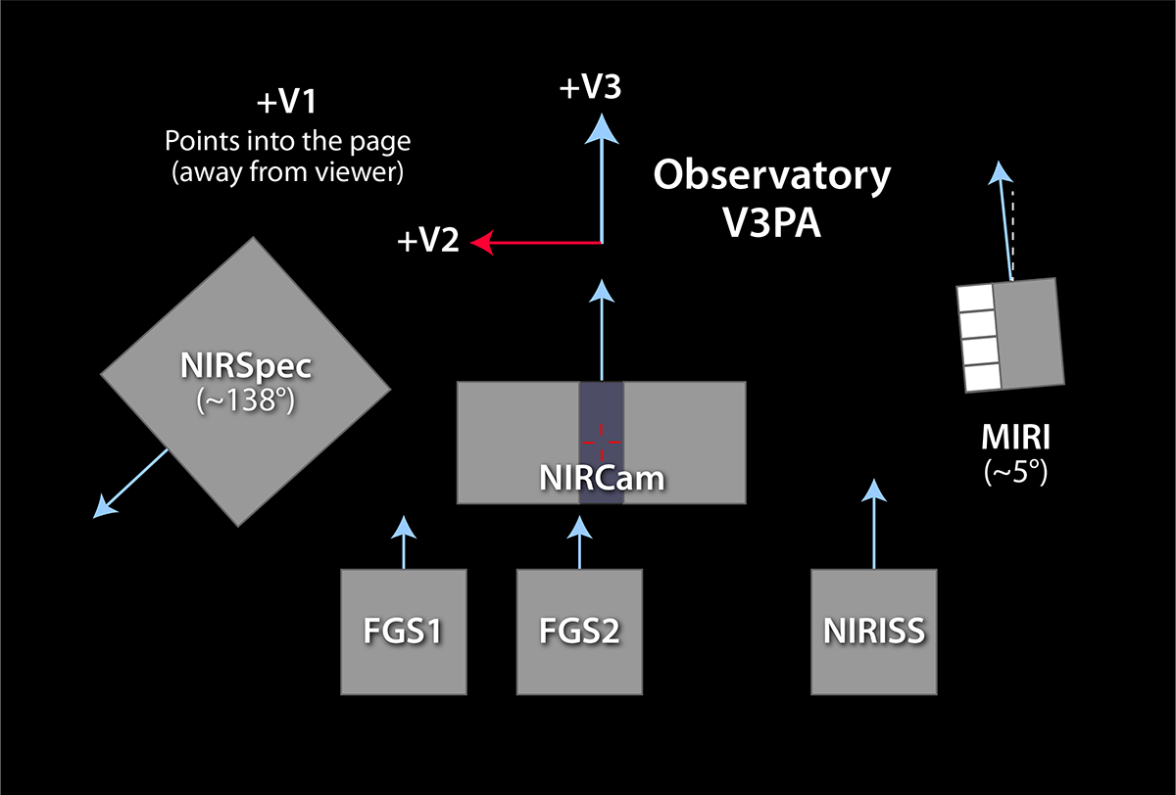
JWST Position Angles
V3PA is the position angle of
the V3 observatory axis when
Projected on the sky
(measured ‘east of north’).
The reference axes of all SIs
except NIRSpec are closely
aligned with the V3 axis.
Notes:
Sometimes, a specific orientation of the FOV is needed/desired (e.g. for Coronagraphy, Imaging Mosaics, NIRSpec MOS). In these cases, it is important to know the availability of the V3PA of a specific aperture as a function of time.
Rotates around during the year

Slide 8
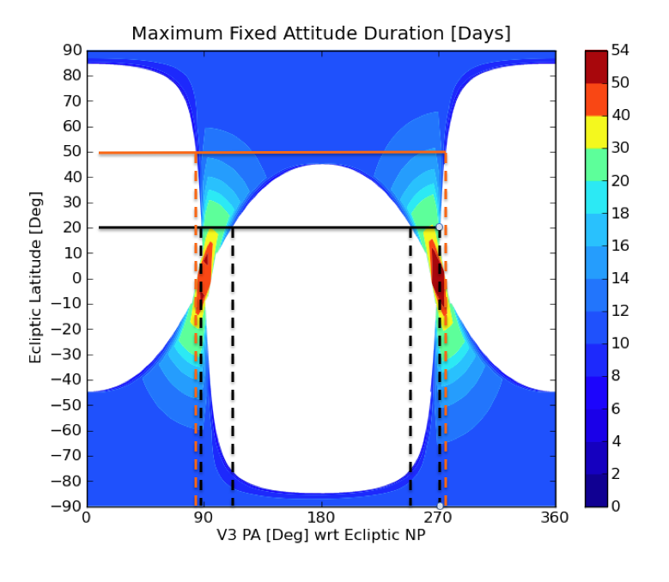
Position Angle depends on Galactic Latitude
Below +/- 45º ecliptic latitude, the range of available position angles becomes increasingly restricted.
However, the length of time the observatory can stay at the same position angle increases!
Note that over much of the sky, the observatory can only maintain the same position angle for about 10 days.
Time at given PA (days)
Limited PA range (but long time at same PA)
Notes:
The limitations in the JWST orientation imply that specifying a strict PA requirement could make the observation non-schedulable. This is where the target visibility tools become useful.

Slide 9
Visibility Tools

Slide 10
The JWST Visibility Toolset
General Target Visibility Tool (GTVT)
Shows visibility and position angle as a function of time for all science instruments
Simple PYTHON command line tool available in AstroConda
Output (plots and/or tables) can be saved to files
Moving Target Visibility Tool (MTVT)
A variant on the GTVT for moving target support.
Coronagraphic Visibility Tool (CVT)
A GUI-driven visibility tool with added functionality for coronagraphy
Focused on MIRI and NIRCam coronagraphic modes
Tools provide ecliptic coordinates of each target for reference
JDox:
General Target Visibility Tool Help
Moving Target Visibility Tool Help
Coronagraphic Visibility Tool Help
Notes:
GTVT: When visiible, what PAs?
MTVT: A "subset" for solar system targets, HORIZONS database
CVT: Where the target falls in FOV of coronograph

Slide 11
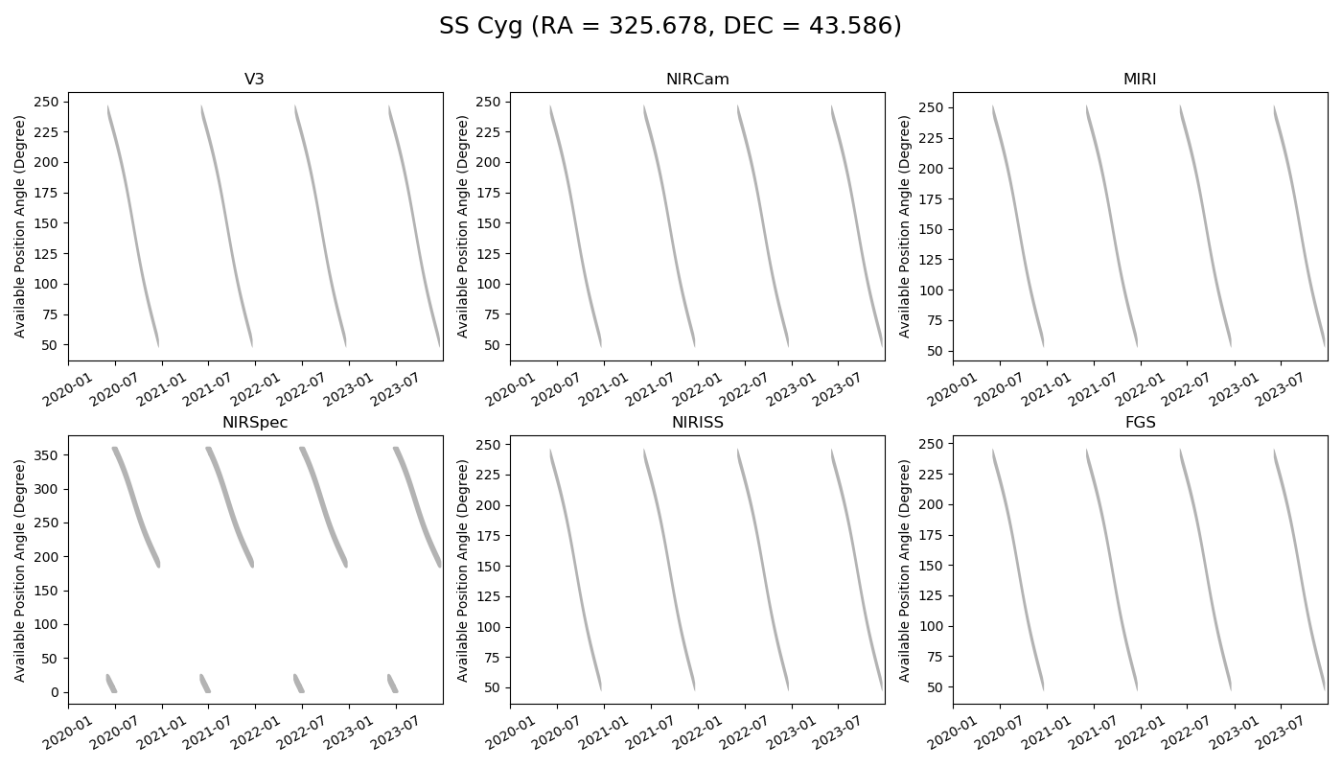
GTVT command line examples -- plots
jwst_gtvt 325.678 43.586 --name "SS Cyg"
(Runs and opens an interactive plot window for all five SIs on the screen. No save file produced. Close plot window to exit program.)
jwst_gtvt 325.678 43.586 --name "SS Cyg" --save_plot SSCyg_all.png
(Just saves plot file, does not open interactive plot window.)
Plot on screen is interactive; you can pan and zoom as needed to see details.
Notes:
Window or file as you like

Slide 12
GTVT command line examples -- output
jwst_gtvt 325.678 43.586 --name "SS Cyg" --save_plot SSCyg_all.png --save_table SSCyg1.dat
(Saves both outputs to the files specified; no interactive.) Here is what the top of the Table looks like:
Ecliptic latitude
Summary of overall visibility windows
Long list of available PAs for each day and instrument mode.
Notes:
Notice that, since the target is above 45 degrees in Ecliptic Latitude, it is visible to JWST for about 200 days each year, beginning in early June and ending around Christmas.
Make your own plots

Slide 13
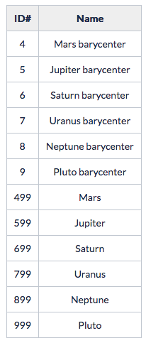
The Moving Target Visibility Tool
Installed as part of the GTVT
Output plots and tables very similar to GTVT
Used primarily for solar system objects (planets, asteroids, comets, etc.)
Instead of target coordinates, MTVT uses target names/designations (from JPL/Horizons database)
Examples: jwst_mtvt Ceres (for asteroid/dwarf planet Ceres) jwst_mtvt 4 (for Mars barycenter) jwst_mtvt 4 –smallbody (for asteroid 4, a.k.a. Vesta)
Horizons Planet designations

Slide 14
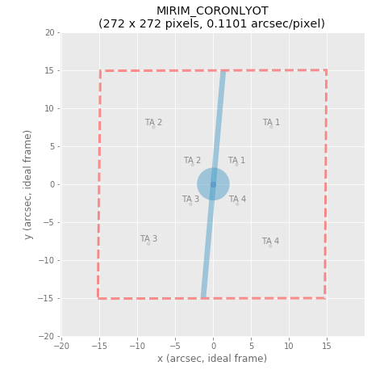
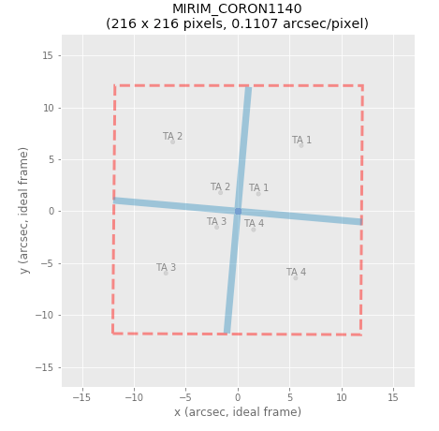
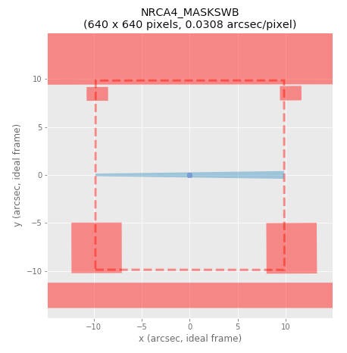
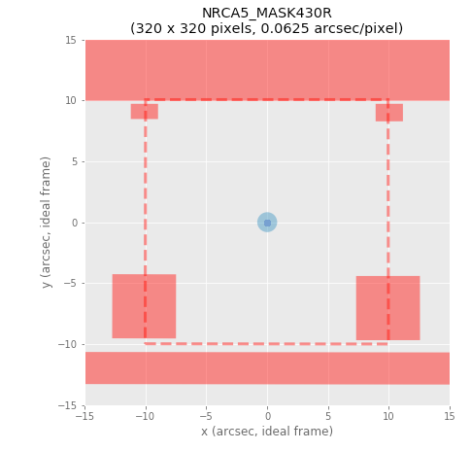
CVT – when (not) to observe planets/companions
The Coronagraphic Visibility Tool is a GUI-driven App that serves to visualize
which PA values (i.e. observation dates) are suitable for coronagraphic
observations of companion sources (e.g. exoplanets).
The issue being addressed is that each coronagraph has certain ‘exclusion’ regions
that should be avoided for the companion:
Notes:
The CVT tells us when (which days of the year) the companion would be located in ‘bad’ spots within the aperture – these dates should be avoided!
"Support bars" or border between two quadrants; days to a week

Slide 15
The CVT Graphical User Interface
Notes:
- both panels have been enlarged to show the details.
- a single companion has been added.
- clicking on either plot highlights the point in the other plot.
Notes:
Click in the blue area, will show the times on the left

Slide 16
Estimating the Background Emission in JWST Exposures

Slide 17
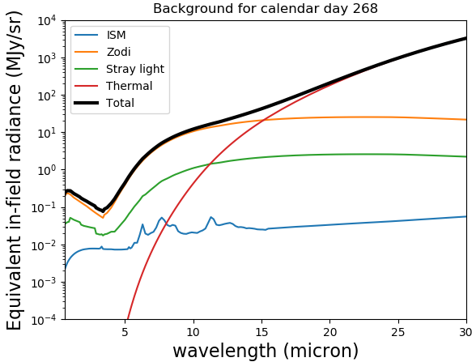
The JWST Infrared Background
There are various sources of unwanted ‘background’ light that affect JWST observations:
For some observing modes, this background light becomes the dominant noise source, i.e. the limiting factor for sensitivity
In those cases, one should try to minimize the sky background
APT allows the use of a ‘special requirement’ that will limit scheduling to low background periods.
For a more pro-active analysis, STScI offers the JWST Background Tool (JBT).
Notes:
Can use a special requirement for low background, need to justify
Use tool to measure (mJy per steradian)

Slide 18
The JWST Background Tool
Relevant for all science cases that are background-limited (e.g. imaging of faint high-z galaxies)
Simple PYTHON command line tool available in AstroConda
Example: jwst_backgrounds --day 268 --thresh 1.1 --showsubbkgs 53.1625 -27.7914 4.4
For a given target (RA, Dec in degs) and wavelength (in μm), the JBT will:
plot the spectrum of all background components vs. calendar day (see previous slide)
visualize the number of days that the target is observable (at a specified wavelength) below a selectable background threshold (typically within 10% of the minimum level). These plots are a.k.a. ‘bathtub’ curves (see next slide).
write the ASCII data for the background spectrum and bathtub curves to file
Notes:
1.1 = 110% of min, wavelength

Slide 19
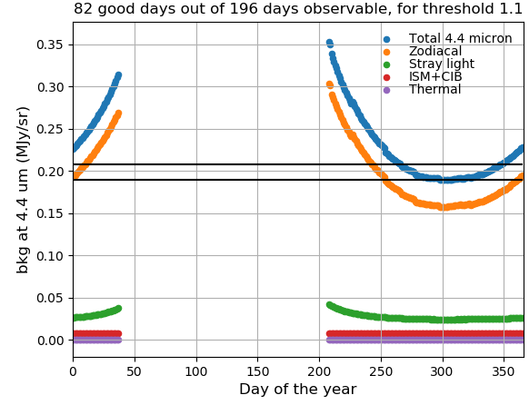
The JWST Background Tool
Example ‘Bathtub curve’:
Minimum x threshold
Minimum
For installation details and additional instructions, see JWST Background Model How JWST Backgrounds Vary The Backgrounds Tool
Notes:
The JWST background is below the specified threshold during the period between days ~265 and ~350. This window will automatically be used for scheduling if the ‘low background’ special requirement in APT is selected.

